Slide 1
Program Overview
A Comprehensive Literacy Solution for Today’s Culturally Diverse Classroom! Grades K-6

Slide 2
The Foundation Purposeful scope & sequence and spiral review with repetition cycle Frequent application to real reading and writing experiences Built-in differentiation for efficient use of instructional time Print and digital phonics tools

Slide 3
Targeted Intervention Resources to Support Opportunity Gaps Quick Checks inform exit/entry placement, saving teachers time. Addresses specific skills tied to assessments for clear next steps. Instruction scaffolds students to on-grade-level expectations.

Slide 4
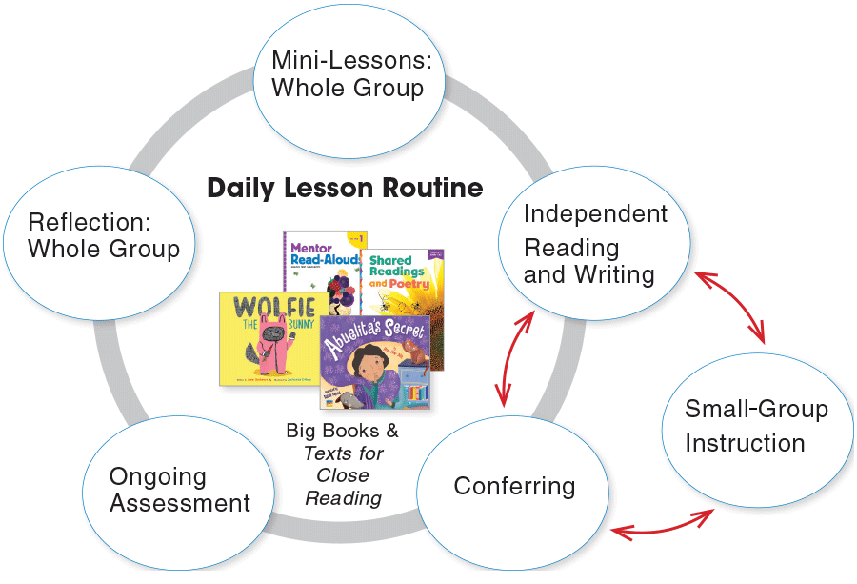
The Time Benchmark Advance Makes Efficient Use of Your Instructional Time Predicable routines provide effective use of your time block. Built-in gradual release of responsibility from whole group to small group/independent time. Flexible daily lesson plan can fit your district’s language arts block, providing a quick start to implementation.

Slide 5
The Technology Online Portal for Students, Teachers, and Administrators All Benchmark Advance print components are available digitally, plus additional content and software are available digital-only! Easy-to-access digital library Available Anywhere, Anytime

Slide 6
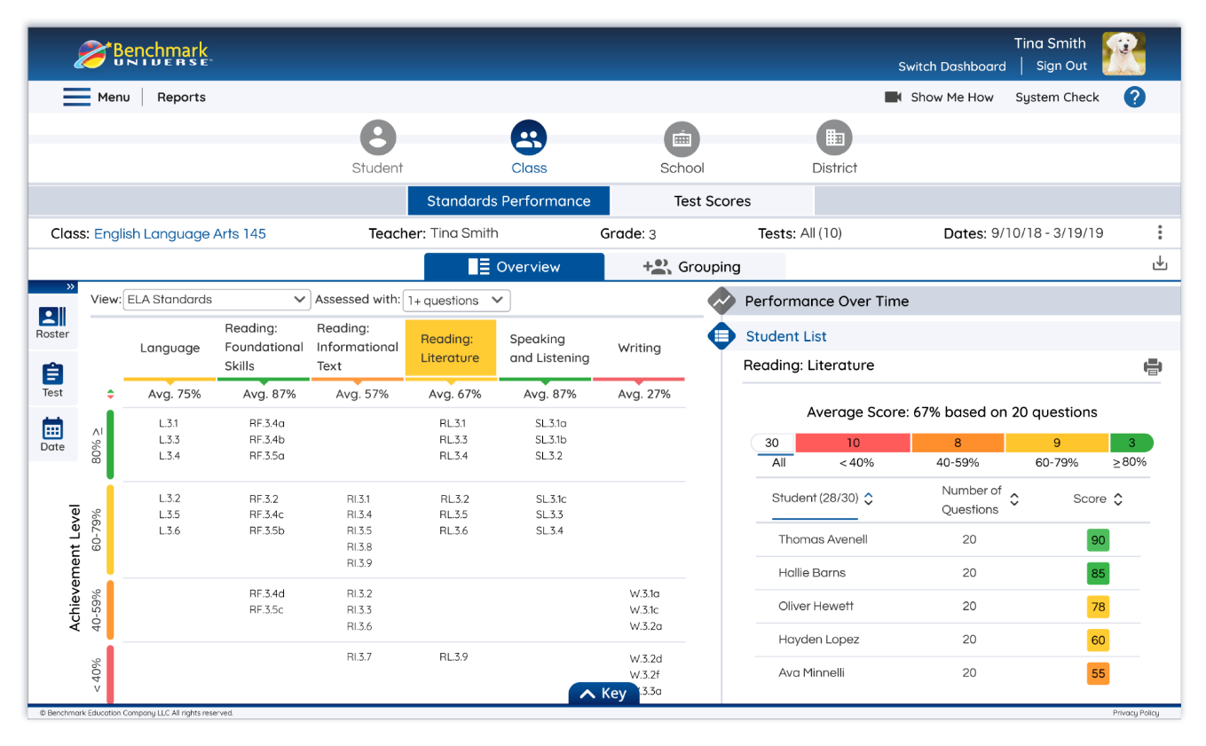
The Data Tools to Inform Instruction and Monitor Student Prepare students for the format and environment of state assessments. Mirrors high-stakes assessment environment Aligns with ELA Standards Weekly and Unit Assessments, Interim Assessments, and Performance Tasks are available at every grade, K-6.

Slide 7
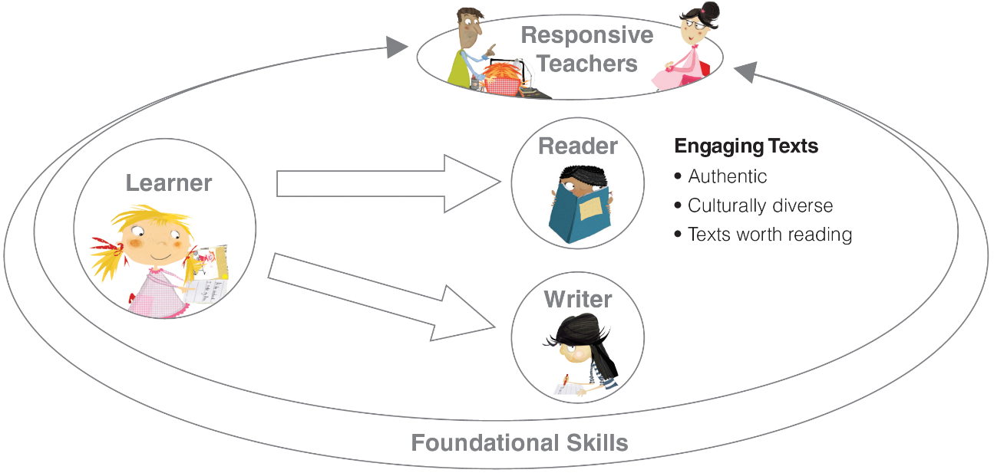
Any questions or concerns regarding the Title I Reading program here at School 5 or Benchmark Advance please contact me at the following email address.
Mrs. Danielle Saldiveri
Title I Reading/Testing Coordinator
dsaldiveri@yonkerspublicschools.org

Slide 8
Program Overview
Click on “Program Overview” and hit play on the video

